Slide 1
Eniac Discount Pricing Strategy
Presented by:
Satyendra KUMAR Hassan MERAI Nabil ZRIGUI

Slide 2
Is Product Discount a Smart Choice?
Marketing Team
Beneficial in the long run
Improves customer satisfaction
Increases the bottomline
Investors
Impact of aggressive discount
Stick to quality segments

Slide 3
Outline
Most sold brands
Most revenue generation
Relationship between discount and product sale
Conclusion and recommendations

Slide 4
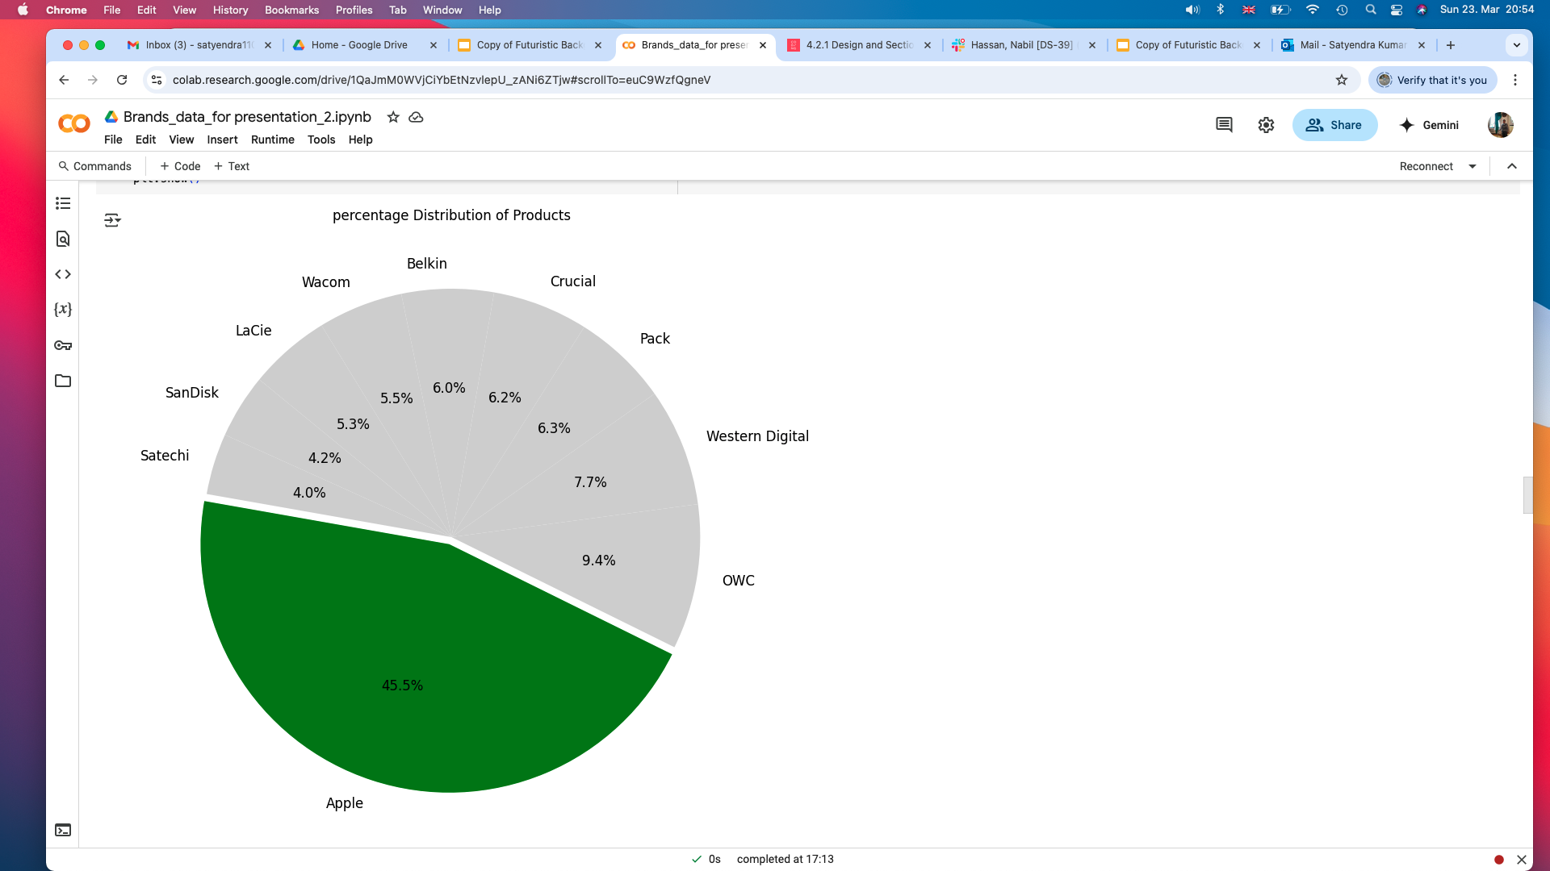
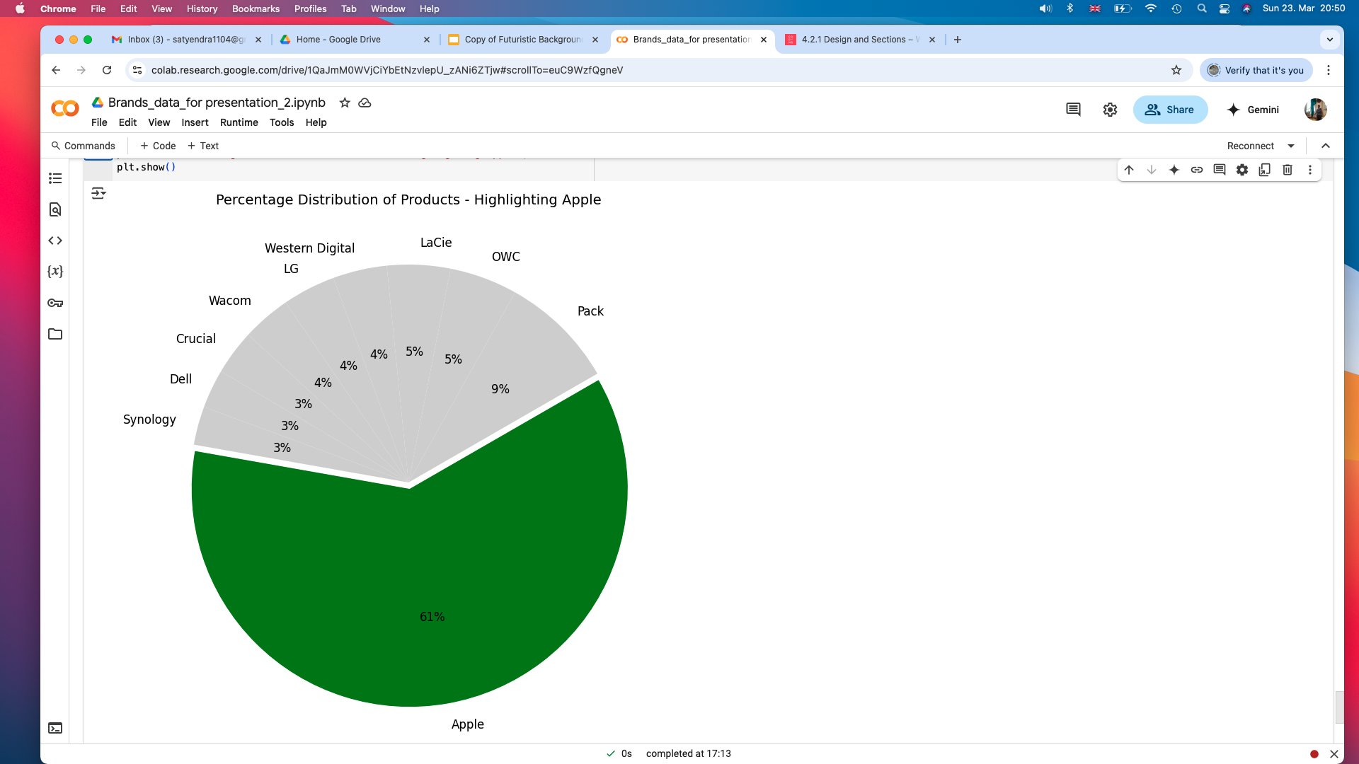
Percentage Product Distribution
Percentage Revenue
by Brands

Slide 5
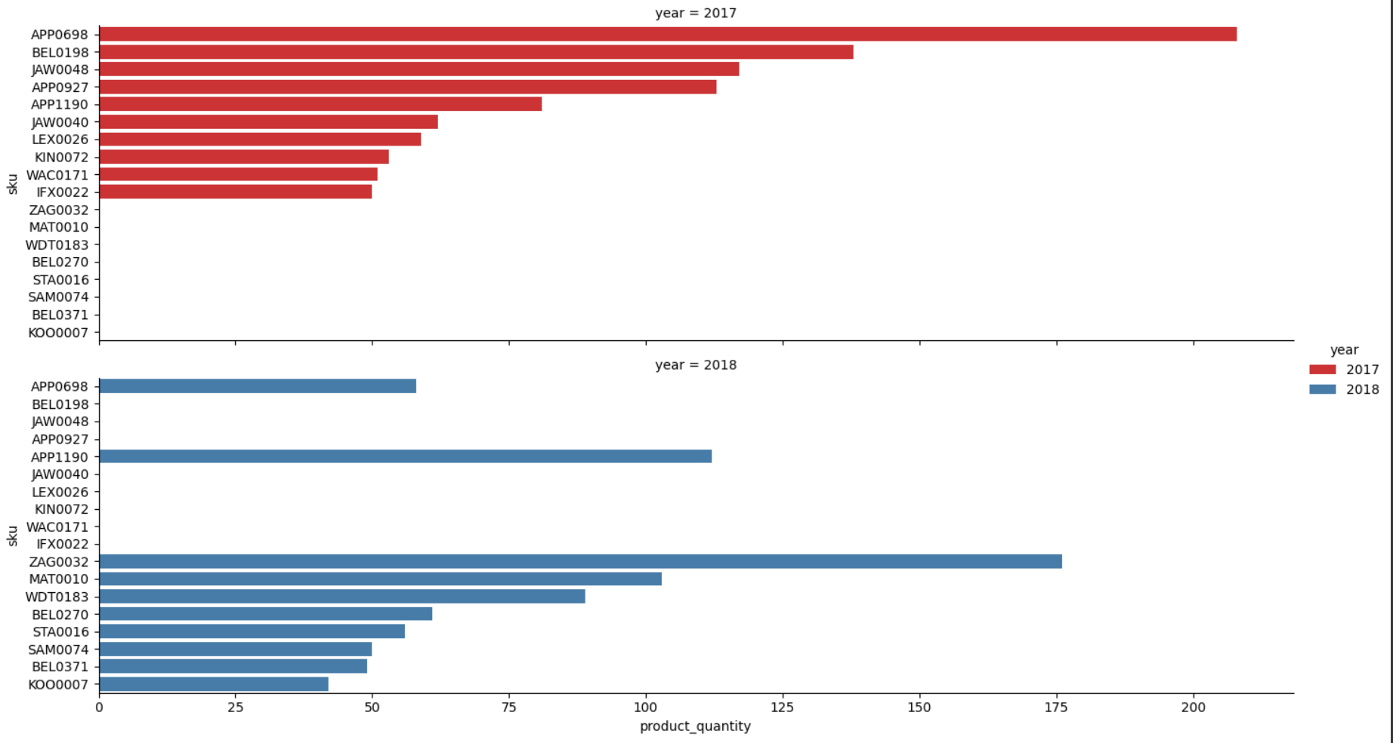
How Selling Behavior changes from 2017 to 2018

Slide 6
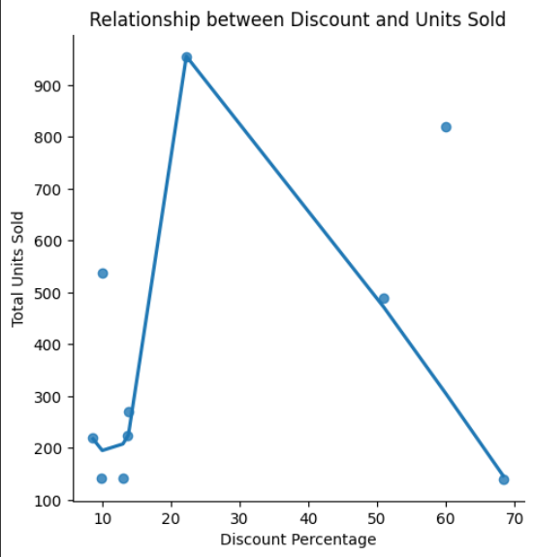
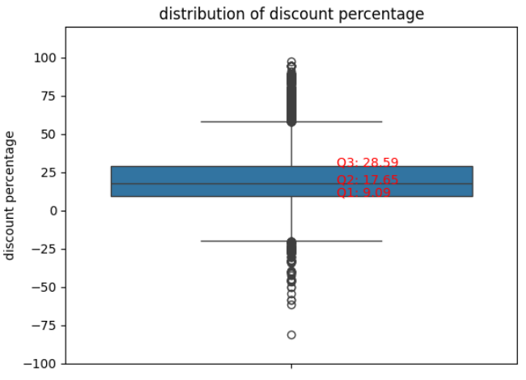
The Three Quartiles and Outliers of The Discount Percentage
The Best Discount Rang is between 20% and 35% , with that we can say safely the outliers start from 35%
Discount percentage
Q1 9.09
Q2 17.65
Q3 28.59
IQR = Q3 - Q1 = 19.5
Q3 + 1.5 * IQR = 57.84 %

Slide 7
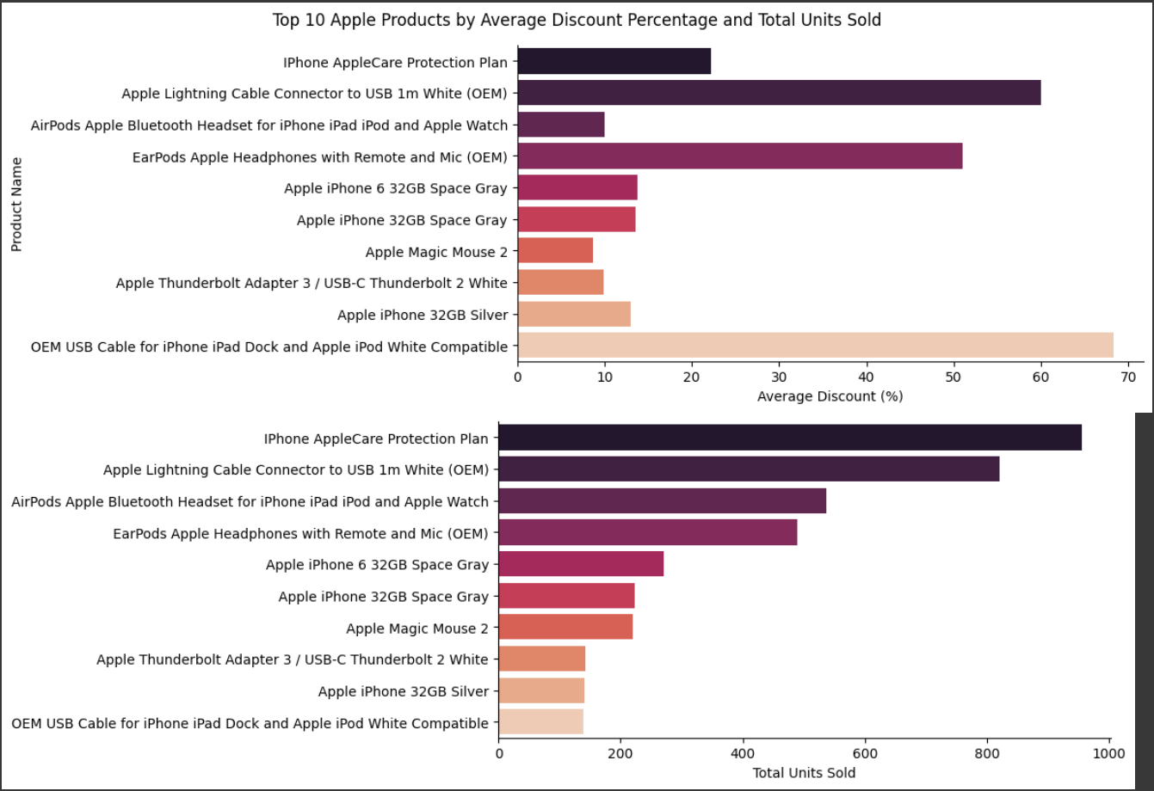
Average Discount and Total Units sold of The Top 10 Apple Product

Slide 8
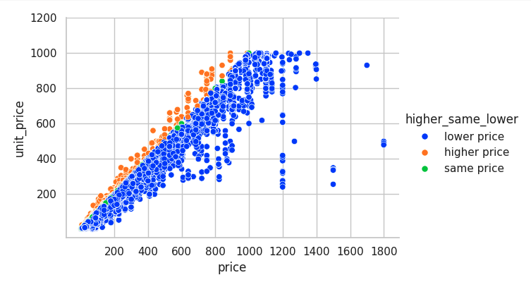
The Relationship Between The actual Price and The Selling Price
Anomalies

Slide 9
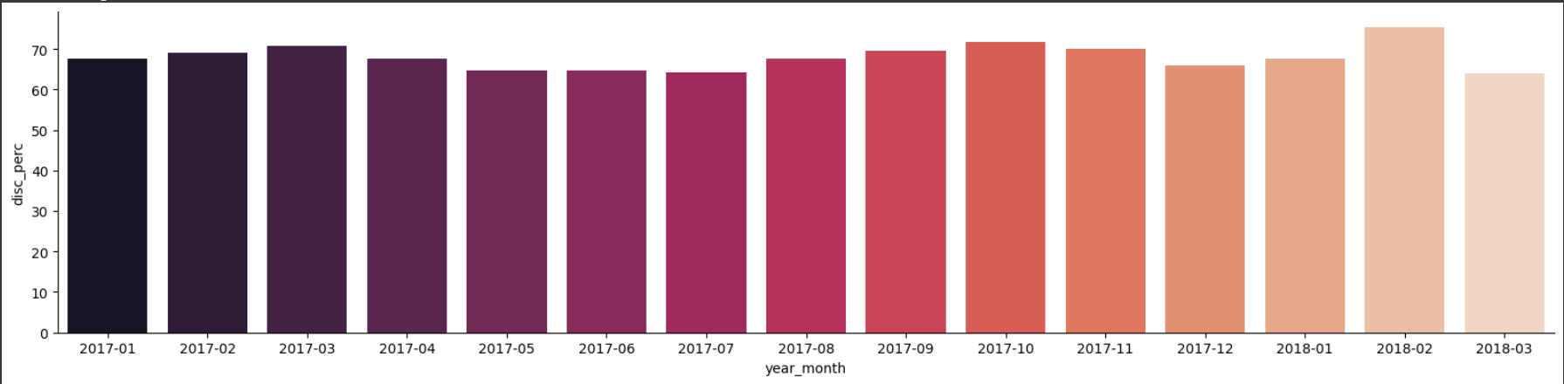
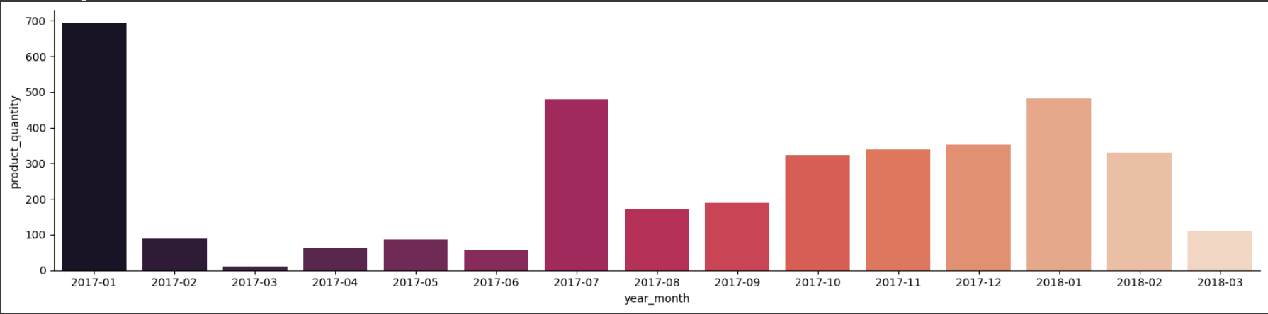
Percentage and The Amount being Sold of Product With Aggressive Discount

Slide 10
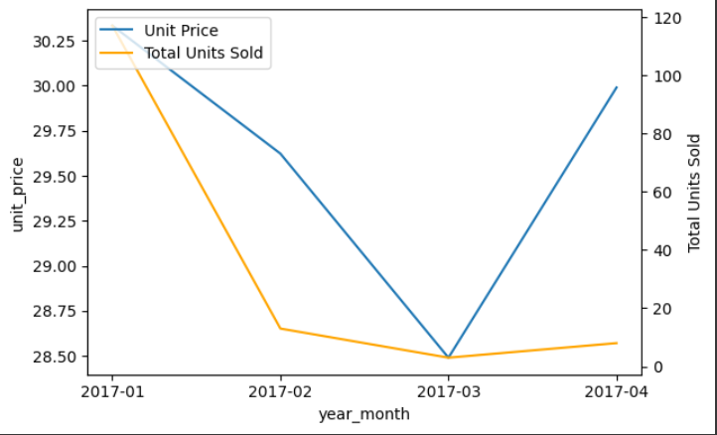
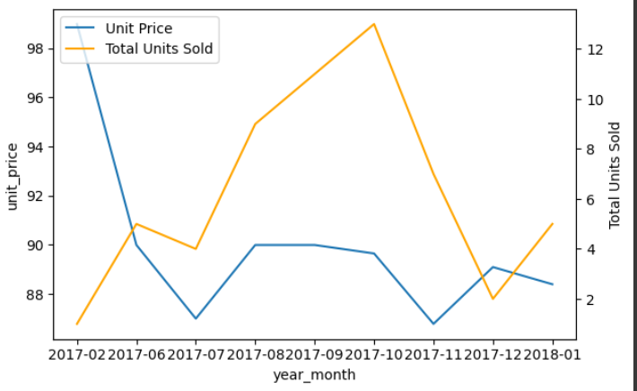
Two Examples from The Best Sold two items in The Time Range
Top: Activity Monitor Band Bottom: DLink Baby Monitor

Slide 11
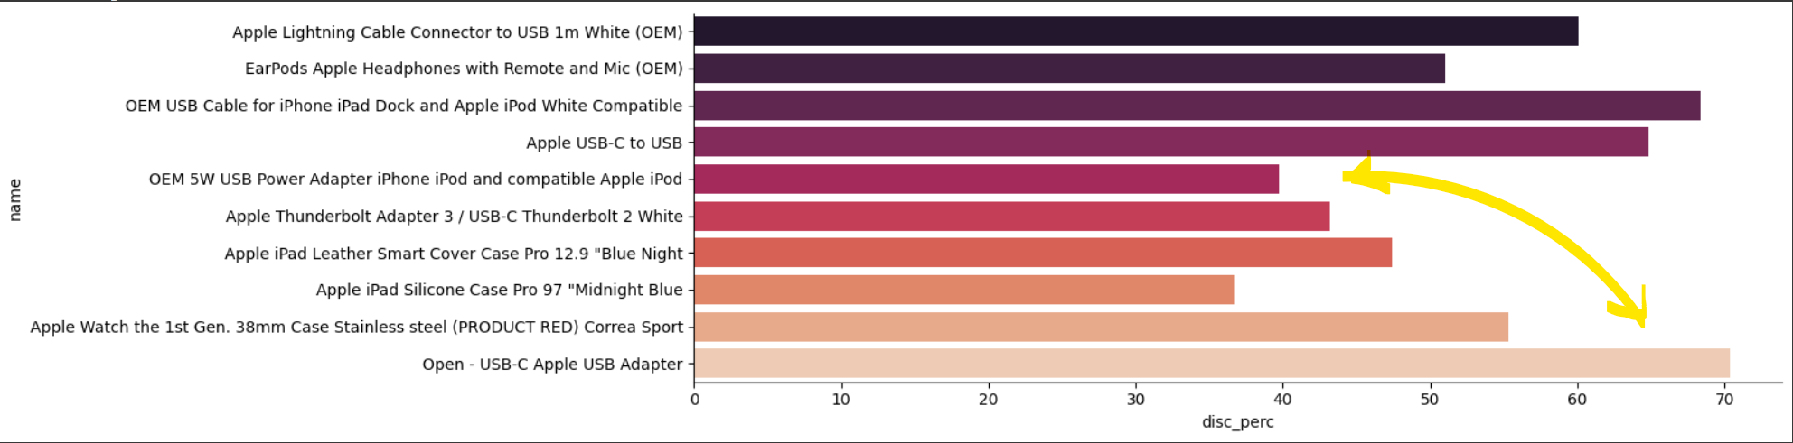
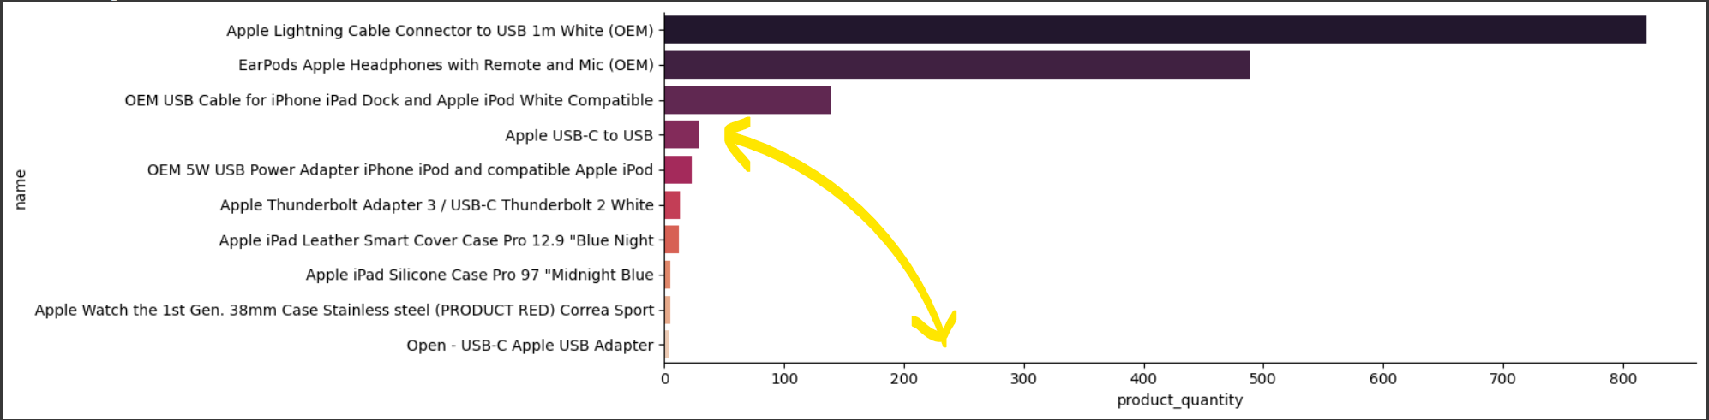
Top 10 Apple best sold Products with Aggressive Discounts

Slide 12
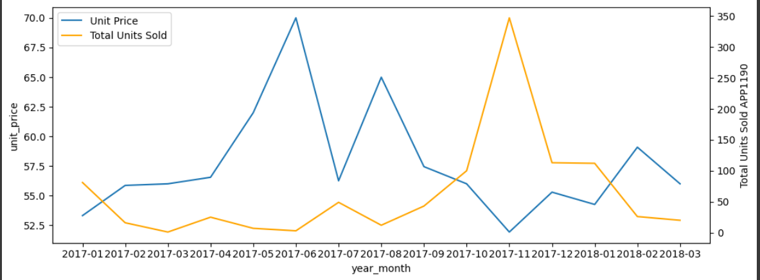
Best sold Apple Product(priced more than 50€)
The relationship between the number of sold items and the discount over time

Slide 13
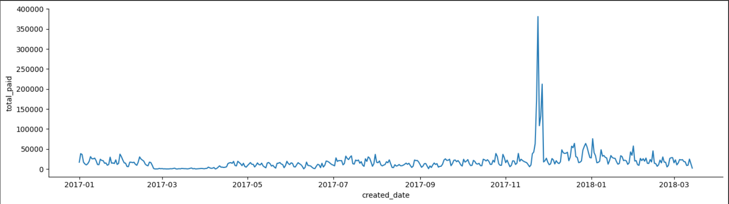
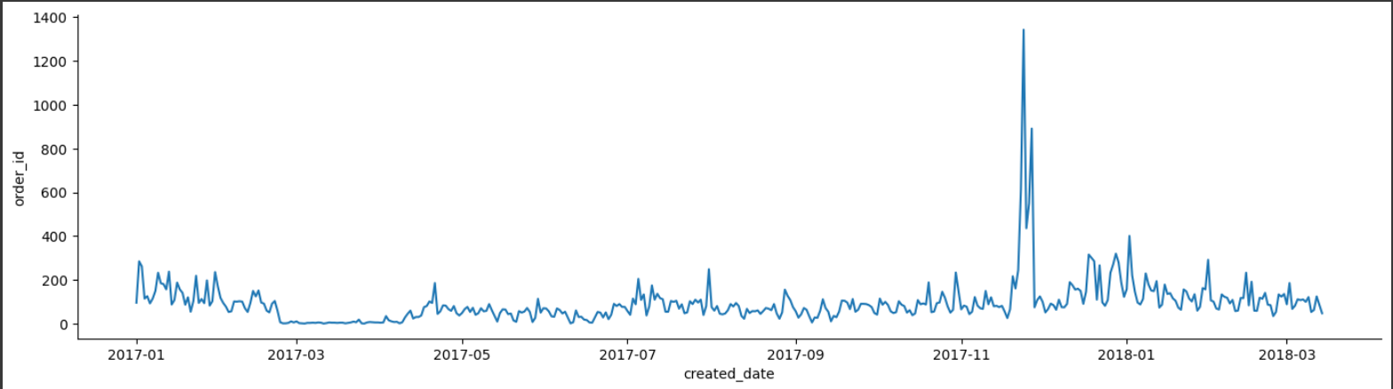
Total Paid and Number of Orders over Time

Slide 14

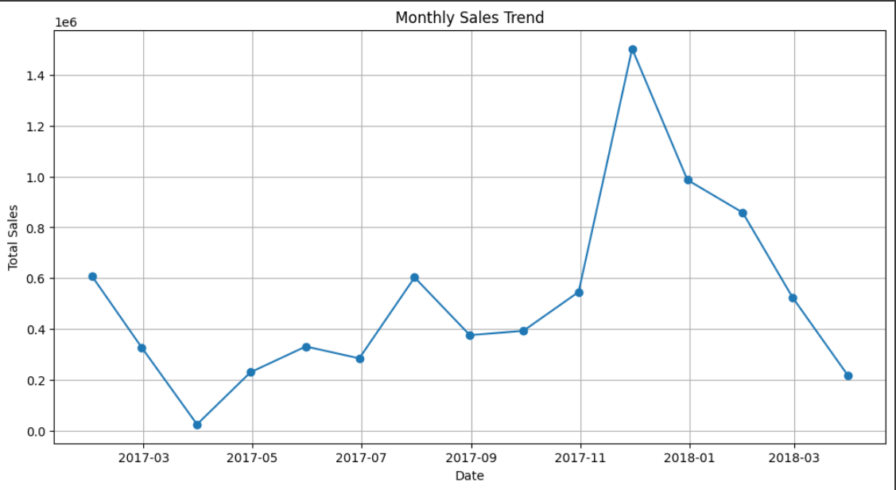
The general Trend in The Total Sales over Time

Slide 15
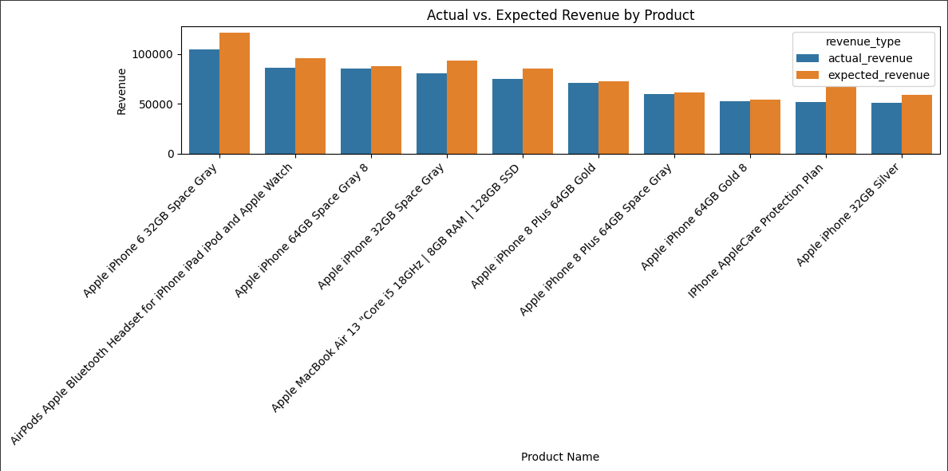
A Comparison between Actual Revenue and Expected Revenue Of The Top 10 Apple best Actual Revenue products

Slide 16
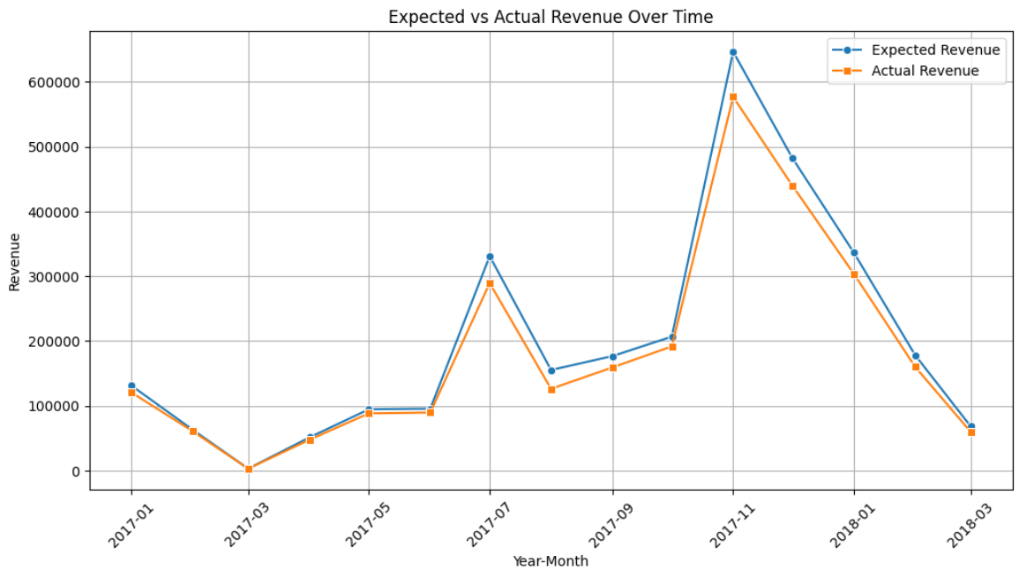
Expected Vs. Actual Revenue of The Apple Products over Time

Slide 17
As a result of our analysis, we found that we cannot forgo price reductions, even significant ones, as they are essential for clearing out outdated stock and products that did not sell well in the market. However, these discounts must be strategically implemented:
1. The discounts should not exceed 35% or 40% at most.
2. They should apply to selected products rather than all items, especially those nearing out date and expiration.
3. Promotions and discounts should be limited to specific seasons rather than spread throughout the year. It would be advisable for the marketing department to review our report to determine the best timing for these offers.
Furthermore, we were unable to determine net profit and the impact of the discounts on it, as the data does not contain relevant information. Instead, we analyzed overall revenue as an indicator of net profit.
Maintaining our position in the quality segment is crucial. The proof of this is that most of our sales and revenues come from Apple products, which are of high quality. However, staying in the quality segment does not contradict offering certain discounts in the structured manner we outlined.
Finally, the decline in sales volume in the first quarter could be a natural consequence of the sharp increase in sales during the last quarter of 2017, which saturated the market and led to a reduced purchasing demand.

Slide 18

Thank You For Your Attention

